Slide 1

KKR&KSR INSTITUTE OF TECHNOLOGY AND SCIENCES
(Approved by AICTE, Permanently Affiliated to JNTU Kakinada, Accredited by NBA & Accredited by NAAC 'A'Grade,
Vinjanampadu (V) Vatticherukuru (M), Guntur (DT) – 522017)
DEPARTMENT OF INFORMATION TECHNOLOGY
IMAGE GENERATION WITH STYLE TRANSFER
PROJECT TEAM:
20JR1A1242
20JR1A1259
20JR1A1261
20JR1A1266
PROJECT GUIDE:
B.NAGAESWARI
ASSISTANT PROFESSOR

Slide 2
ABSTRACT
In the world of digital art, Image Style Transfer is a captivating technique that allows artists and enthusiasts to infuse their pictures with the charm of famous artistic styles.
This process involves seamlessly applying the visual elements of one image onto another, resulting in a harmonious blend of content and style.
This abstract explores the natural and intuitive aspects of Image Style Transfer, shedding light on how enthusiasts can effortlessly transform their photographs into visually striking compositions
KEY WORDS:
Neural Style Transfer (NST),Texture Synthesis, Optimization Methods, Instance Normalization

Slide 3
Literature Review
Leading the way in transformative imageprocessing methods for computer vision isNeural Style Transfer (NST), whichprovides apotent medium for artistic expression. The maingoal of NST is succinctly stated in the abstract to create visually striking images by combining the elements of a reference image's style with thecontent of a target image.[1]
Deep neural networks have been useful inadvancing artistic applications and enhancingvisual inventiveness in the quest to createaesthetically pleasing changes. This canvas ofpossibilities is introduced in the abstract, layingthe groundwork for a detailed examination of thecomplex mechanisms behind NST.[2]
NST approaches are based on deep neuralnetworks, namely convolutional neural networks(CNNs). Their significance in capturinghierarchical elements and representationsnecessary for efficient style extraction isemphasised in the abstract. In particular, theresearch explores the use of pre-trained CNNs asfeature extractors, such VGG-19, to make iteasier to extract style and content informationfrom input photos.[3]

Slide 4
As the study goes on, the computing complexityof NST becomes more apparent, whichmotivates a careful investigation of optimization techniques to achieve a trade-off betweencomputational effectiveness and image quality.This idea is echoed in the conclusion, whichconsiders how to balance the requirement forhigh-quality stylized graphics with the demands of real-time applications.[5]
The paper's experimental section develops,demonstrating the suggested NST model'sadaptability to a variety of artistic genres. Apeek of these trials is given by the abstract,which emphasises how flexible the model is withvarious input scenarios and how it can yield visually striking outcomes that are consistent with the selected stylistic references.[6]
As a thoughtful conclusion, the paper’s conclusion summarises the main discoveries and contributions. It acknowledges both the achievements of NST and the inherent difficulty of judging generated images' artistic merit objectively. A cry is raised for additional investigation into more accurate measurements that are in line with human perception as a resultof this reflective moment.[7]
The conclusion extends the view beyond the technical details and imagines the useful applications of NST. It envisions NST being incorporated into commonplace picture editing programmes and tools, democratising artistic expression and enabling a larger audience to engage with digital creativity.[8]

Slide 5
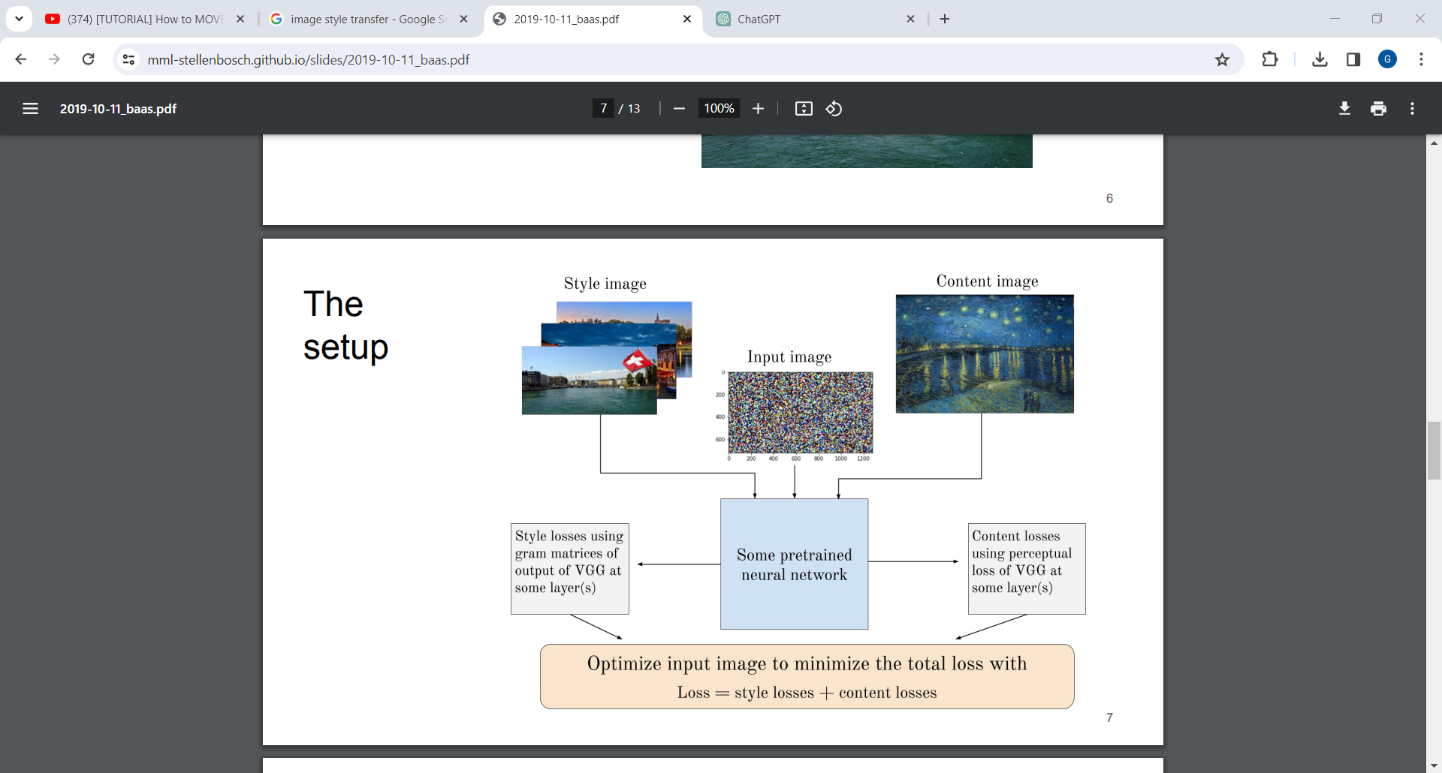
PROBLEM STATEMENT
PROBLEM OCCURS

Slide 6
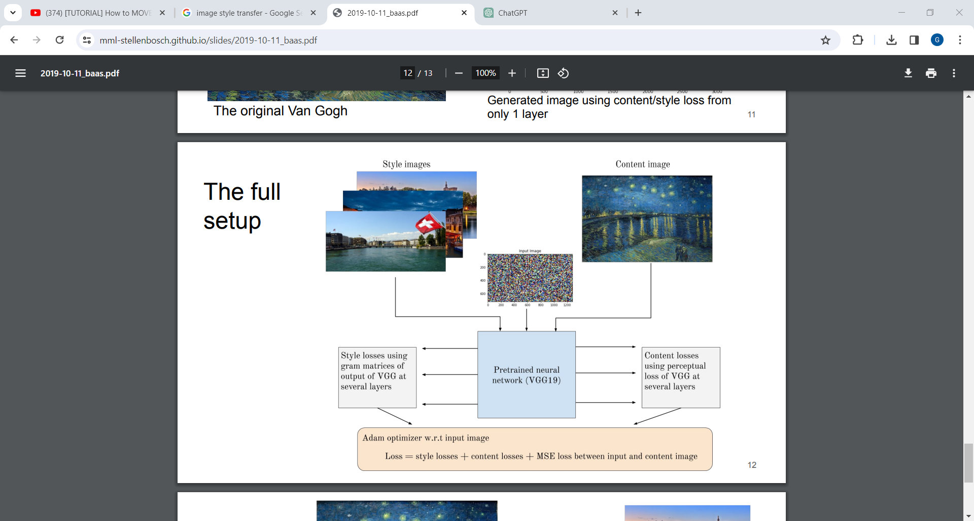
PROPOSED SYSTEM

Slide 7
FEASIBILITY STUDY
1. Project Scope and Objectives
Scope: Implementing a style transfer algorithm for generating artistic images.
Objectives: Create a user-friendly application for transforming content images with artistic styles.
2. Technical Feasibility
Algorithm Selection:
Investigate feasibility of implementing style transfer algorithm.
Assess computational requirements and available libraries/tools.
Data Requirements:
Evaluate availability and quality of datasets for training/testing.
3. Market Feasibility
Identify Users:
Define target audience and understand their needs.
Competitive Analysis:
Analyze existing solutions and competitors in style transfer space.

Slide 8
REQUIREMENT ANALYSIS
FUNCTIONAL REQUIREMENTS
Uploading content and style images.
Implementing the style transfer algorithm.
Displaying the stylized output to the user.
Providing options for users to adjust parameters or select styles.
USER REQUIREMENTS
No need of any heavy requirements.
Needed to upload a content image and style image

Slide 9
NON FUNCTIONAL REQUIREMENTS
These are qualities or attributes the system must have, but they don't relate directly to specific behaviors.
Attributes: Performance, Scalalibity, Usability, Security
SYSTEM REQUIREMENTS
Detail the hardware, software, and network requirements.
For example:
Hardware: Specify the minimum and recommended hardware specifications for running the application.
Software: Specify the required software dependencies, frameworks, and libraries.

Slide 10
USE CASE DIAGRAM OF THE SYSTEM
Load images
Select style
Perform style
transfer
View results
system
user
Save image
Adjust parameters

Slide 11

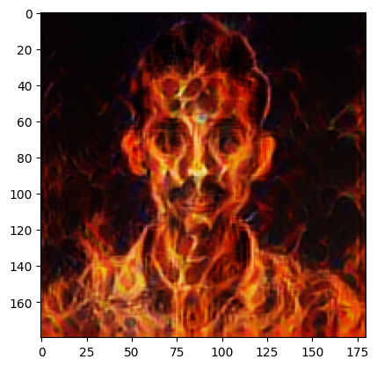

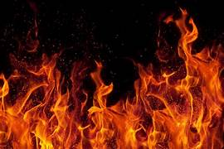
CONCEPTUAL DESIGN
1
2
3
4
BLENDED IMAGE
CONTENT IMAGE
STYLE IMAGE
ALGORITHM

Slide 12
LOGICAL DESIGN
INPUT IMAGES
MODEL(CNN)
LOSS FUNCTION
OPTIMIZATION
OUTPUT IMAGE

Slide 13
ALGORITHM DESIGN
START
Content image
Style image
(INPUT)
Feature extraction
Identity layers
layers
Loss Computation
Content & style variation
Optimization
Output Image
END

Slide 15
HARDWARE REQUIREMENTS
GPU
(OPTIONAL)
STORAGE
CPU
RAM
INTERNET

Slide 16
SOFTWARE REQUIREMENTS
TENSOR FLOW
(OR)
PYTORCH
IDE
LIBRARIES
VERSION
CONTROL SYSTEMS
PYTHON

Slide 17
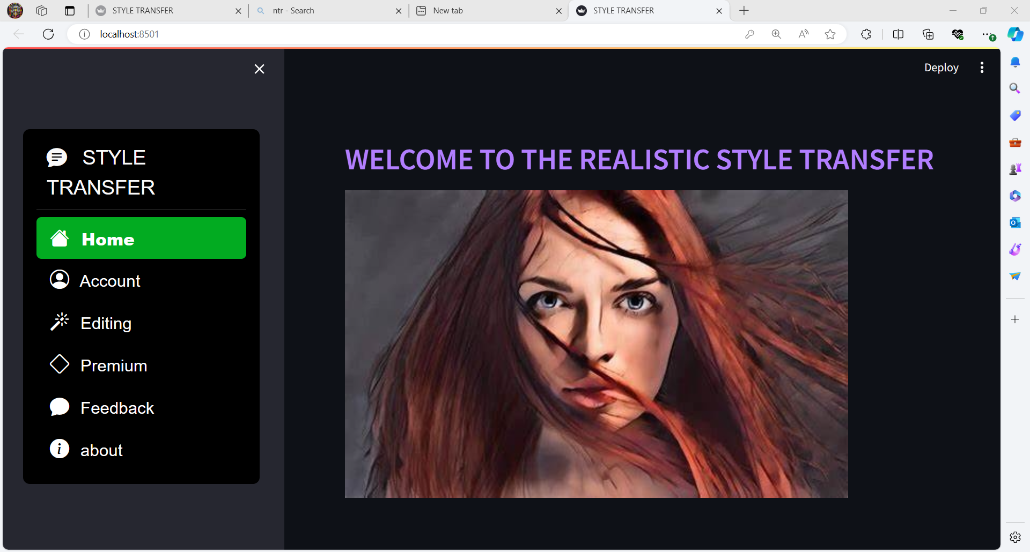
User interface module:-

Slide 18
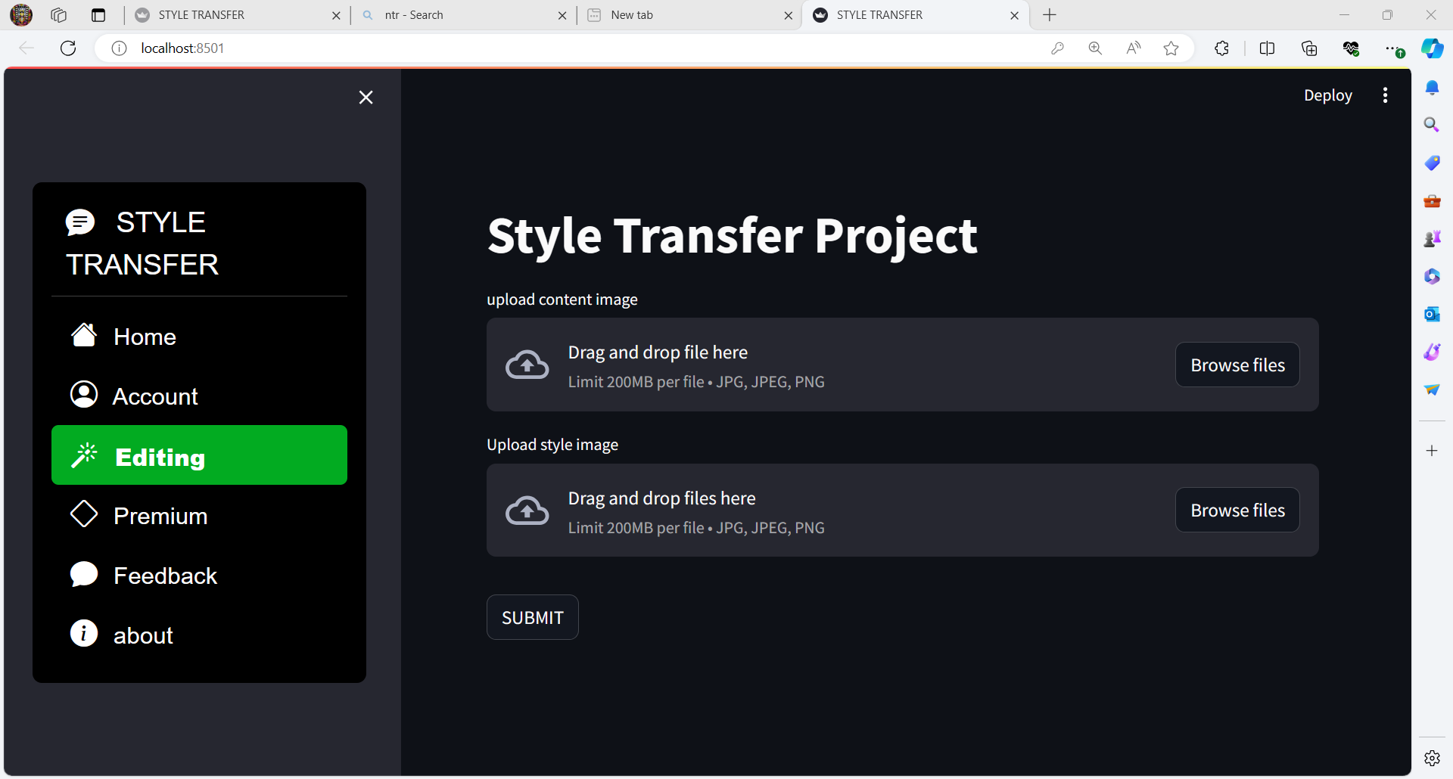
File_uploader

Slide 19
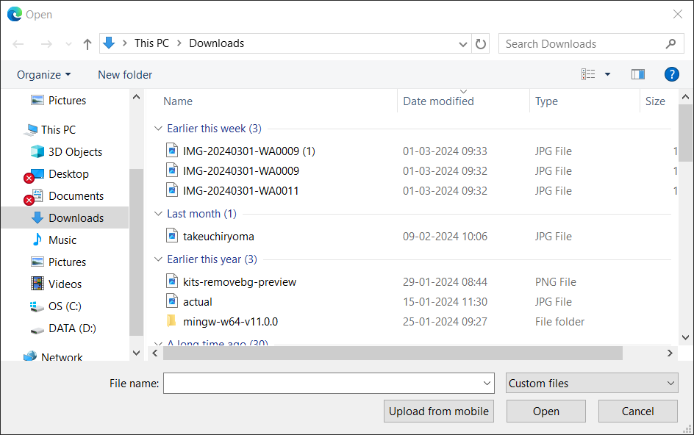

Slide 20
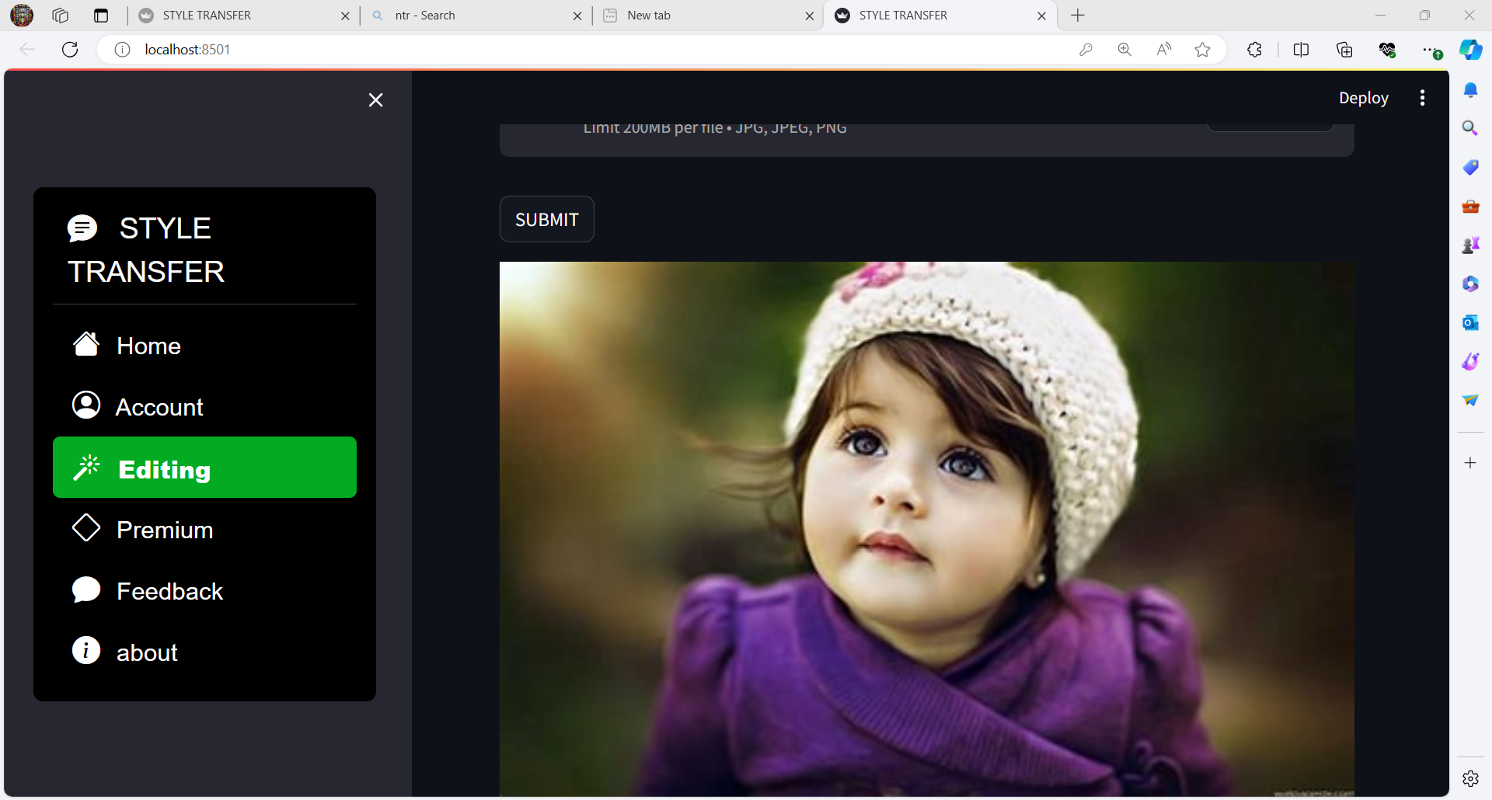

Slide 21
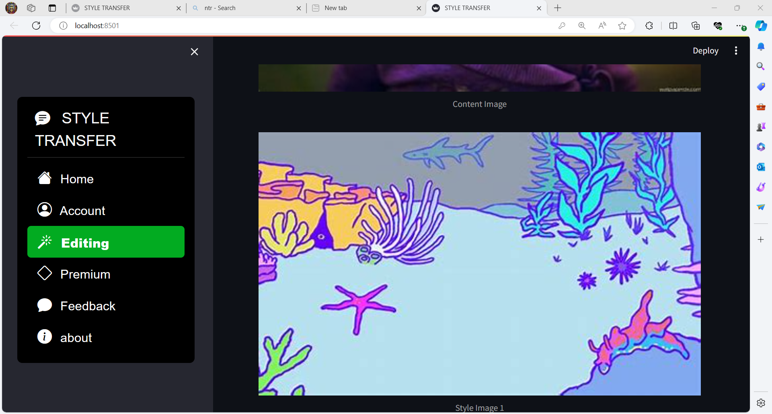

Slide 22
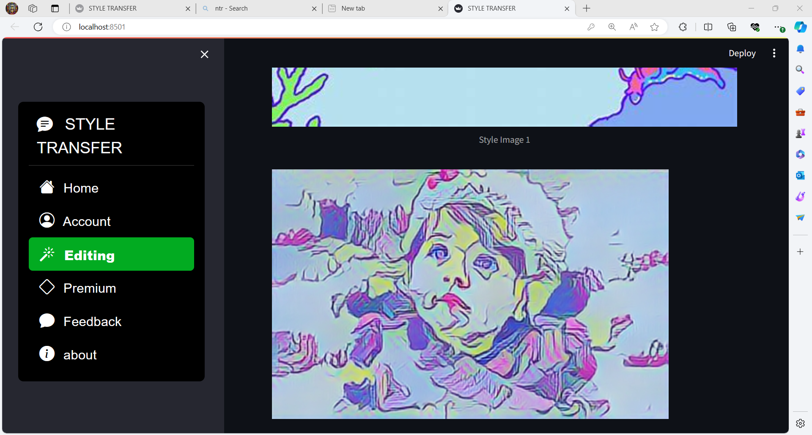

Slide 23
Conclusion
Finally, we combine the two models to achieve the application effect in a specific scenario. But, the migration of details is not in place. The lack of detail in the depiction of different image styles will follow the following two aspects to improve the network’s capabilities:
First, for the already trained model, the generated image has reached a very fast speed, but the training model still takes several hours. I hope that the training process of the model can be optimized and the training time of the model can be improved. Second, for more research on the details of the image, you can add more detail extraction to the network to transfer the style of the image, achieve more realistic comic style migration effects, and imitate different painter strokes and for buildings and characters adapt to different parameters.

